Slide 1
Spectral Clustering
Renato R. Maaliw III, DIT
College of Engineering
Southern Luzon State University
Lucban, Quezon, Philippines

Slide 2
Spectral Clustering
a way to group things that are similar to each other
it uses a concept in linear algebra called eigenvectors and eigenvalues to simplify information and make it easier to work with

Slide 3
Once simplified, spectral clustering can group similar things together.

Slide 4

For example, if you were using it to understand a social network, it could help you identify different groups of people who are connected to each other

Slide 5
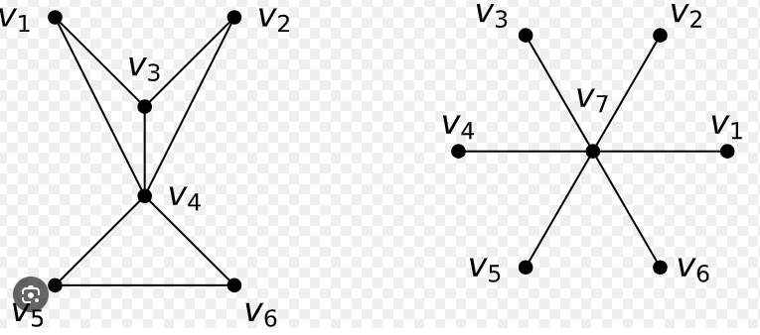
It relies on matrix (graph laplacian) allowing to use it for computing clusters.
We compute the graph laplacian using basic properties of graphs.

Slide 6
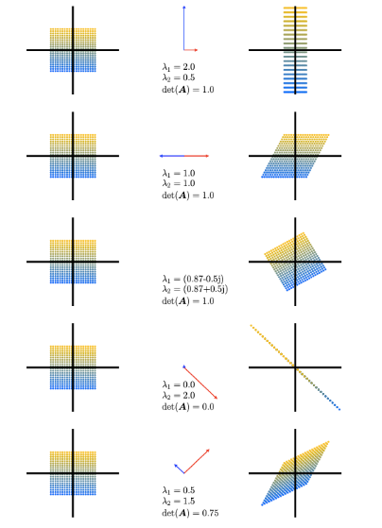
Simply, it turns your data in a network (graph) of similarities, then uses a mathematical “listening” trick (eigenvectors) to discover natural splits

Slide 7
Why do wee need Spectral Clustering?
real data rarely forms neat circles: such as interlocking crescents, spirals, thin bands, or manifold-shaped clouds

Slide 8
Why do wee need Spectral Clustering?
distance-only methods (like K-means) can cut through a crescent, mixing different regions

Slide 9
Why do wee need Spectral Clustering?
spectral clustering respects local neighborhoods and the geometry of the data

Slide 10
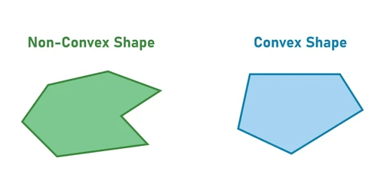
Where Popular Methods Struggle
K-Means: assumes round, equally sized clusters; struggles with non-convex shapes

Slide 11
Where Popular Methods Struggle
Hierarchical (linkage): sensitive to linkage choice; may chain across gaps

Slide 12
Where Popular Methods Struggle
Gaussian Mixture Model (GMM): assumes cluster look like (possibly rotated) ellipses; complex shapes need many components. Has to pass the normality assumptions.

Slide 13
Spectral clustering: uses connectivity rather than global shape assumptions

Slide 14
Thank you very much for listening.

